Slide 1

Grocery Store Management

Slide 2
About me
Bandagorla Dinesh
I completed my B.Tech in Artificial Intelligence and Data Science from
Muthayammal Engineering College in 2025.During my studies, I worked on an exciting project titled “Deep Learning Based Crime Pattern Analysis”, which became a turning point in my career.This project sparked my deep interest in data-driven research and AI applications.As I explored further, I became
passionate about how machine learning can solve real-world problems, especially in complex domains.Motivated by this, I’ve decided to pursue a career in Data Science, a field that is transforming industries and shaping the future.
Linkedin: www.linkedin.com/in/bandagorla-dinesh
Github: https://github.com/BandagorlaDinesh

Slide 3
Agenda
Objective of the project
ER Diagram and schema explanation
Analysis
SQL queries
Business insights
Conclusion
Challenges

Slide 4
Objective of our project:
The main goals of this SQL project are:
To design and implement a relational database for a grocery store.
To retrieve and manipulate data using SQL queries.
To perform data analysis for business insights such as top customers, best-selling products, and revenue trends.
To practice using joins, aggregations, subqueries, and filtering techniques.

Slide 5
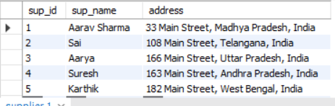
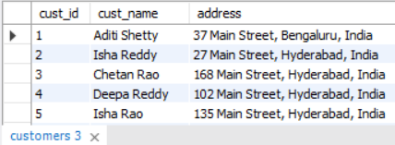
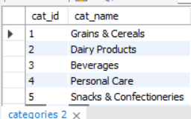
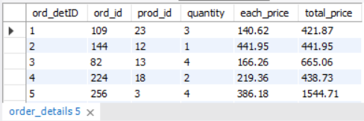
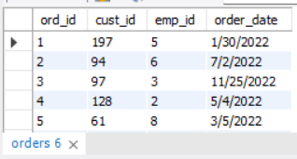
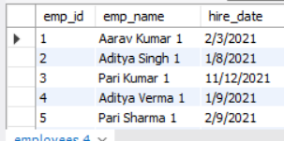
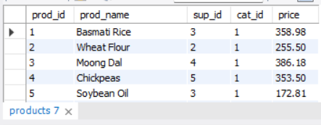
Tables
.
Suppliers details
Customers details
Categories details
Order details
Orders_details
Employees detalis
Products details

Slide 6
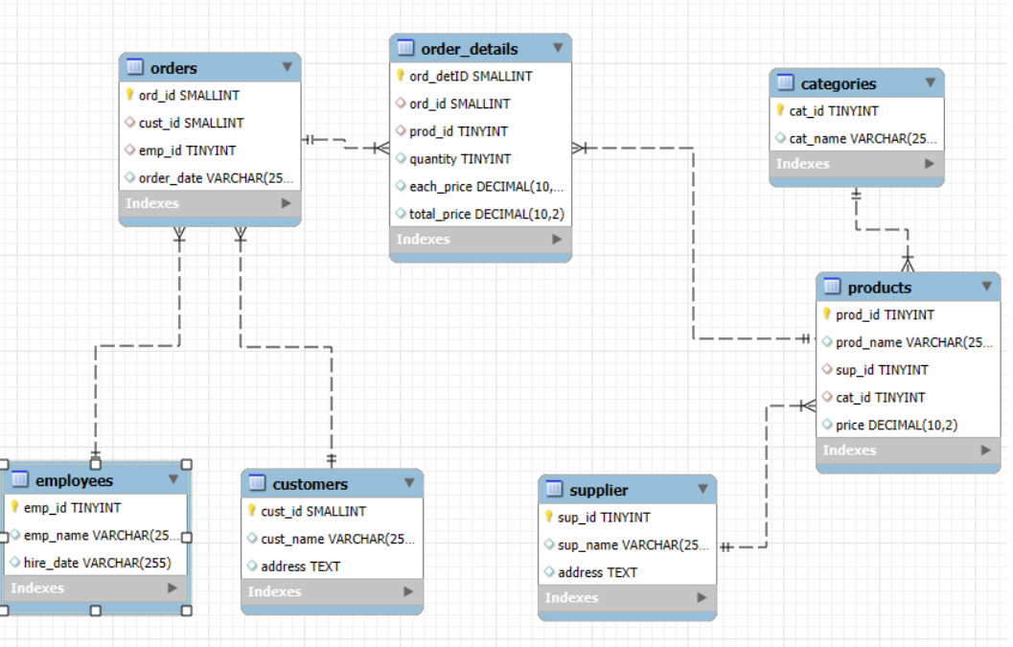
ER Diagram:

Slide 7
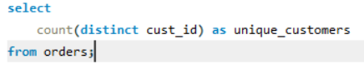
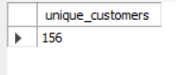
Analysis:1. Customer Insights
How many unique customers have placed orders?
Query
Result

Slide 8
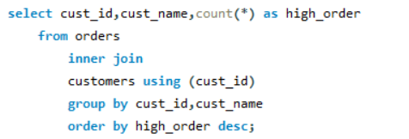
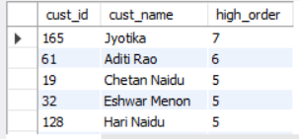
Which customers have placed the highest number of orders?
Query
Result

Slide 9
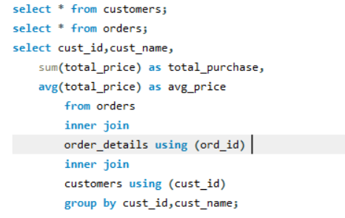
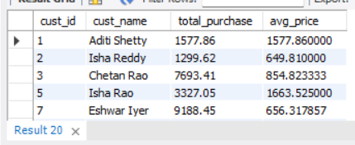
What is the total and average purchase value per customer?
Query
Result

Slide 10
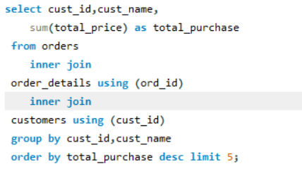
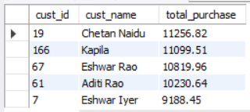
Who are the top 5 customers by total purchase amount?
Query
Result

Slide 11
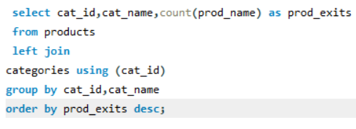
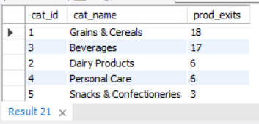
2. Product Performance
How many products exist in each category?
Query
Result

Slide 12
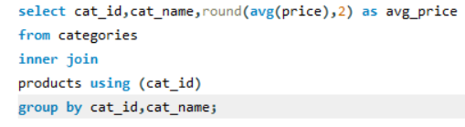
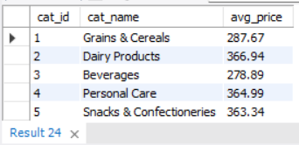
What is the average price of products by category?
Query
Result

Slide 13
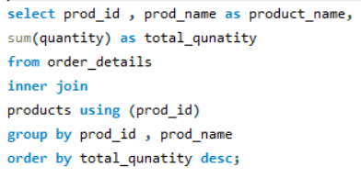
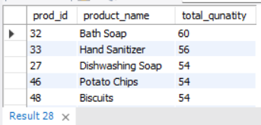
Which products have the highest total sales volume (by quantity)?
Query
Result

Slide 14
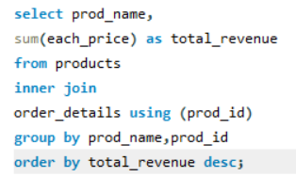
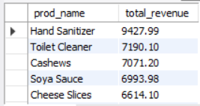
What is the total revenue generated by each product?
Query
Result

Slide 15
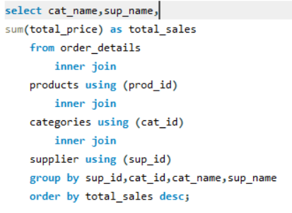
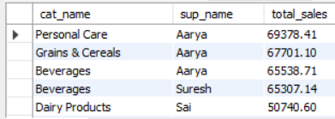
How do product sales vary by category and supplier?
Query
Result

Slide 16
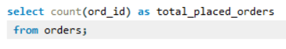
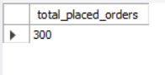
3. Sales and Order Trends
How many orders have been placed in total?
Query
Result

Slide 17
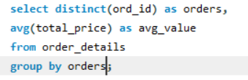
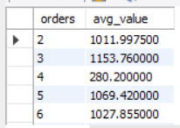
What is the average value per order?
Query
Result

Slide 18
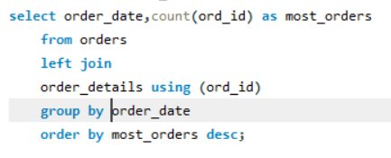
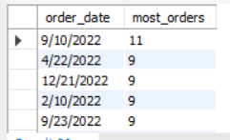
On which dates were the most orders placed?
Query
Result

Slide 19
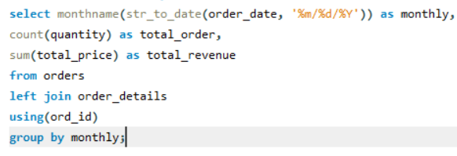
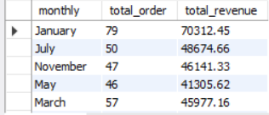
What are the monthly trends in order volume and revenue?

Slide 20
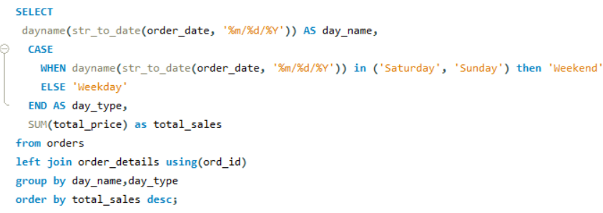
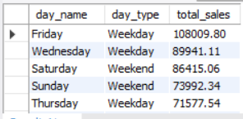
How do order patterns vary across weekdays and weekends?
Query
Result

Slide 21
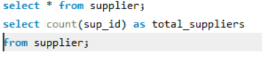
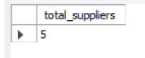
4. Supplier Contribution
How many suppliers are there in the database?
Query
Result

Slide 22
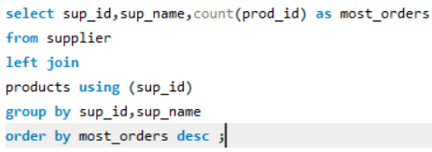
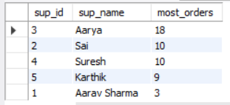
Which supplier provides the most products?
Query
Result

Slide 23
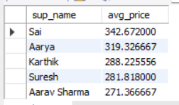
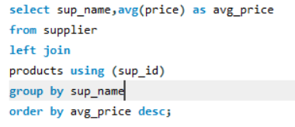
What is the average price of products from each supplier?
Query
Result

Slide 24
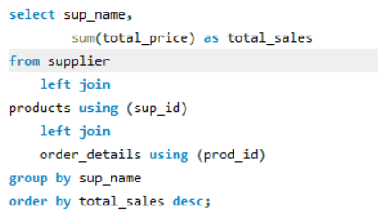
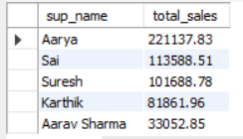
Which suppliers contribute the most to total product sales (by revenue)?
Query
Result

Slide 25
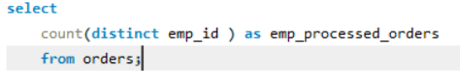
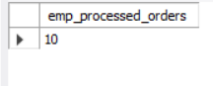
5. Employee Performance
How many employees have processed orders?
Query
Result

Slide 26
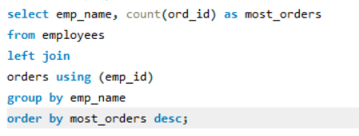
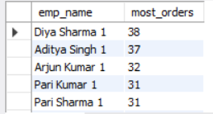
Which employees have handled the most orders?
Query
Result

Slide 27
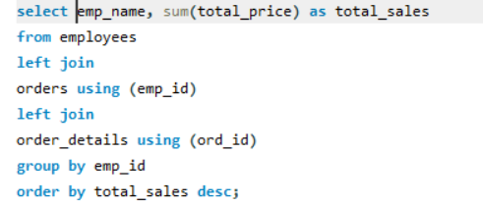
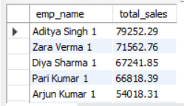
What is the total sales value processed by each employee?
Query
Result

Slide 28


What is the average order value handled per employee?
Query
Result

Slide 29


6. Order Details Deep Dive
What is the relationship between quantity ordered and total price?
Query
Result

Slide 30


What is the average quantity ordered per product?
Query
Result

Slide 31


How does the unit price vary across products and orders?
Query
Result

Slide 32
Conclusion:
There are more products available in Grains & cereals and Beverages category.
Bath soaps and hand sanitizers are the products that ordered in high quantity.
Hand sanitizers and biscuits generated high revenue.
Totally 600 orders are placed by the customers.
January month have seen more no. of orders i.e. 79 and the revenue generated is 70,312.
Totally there are 5 suppliers.
Supplier named Aarya supplies most of the products and the revenue generated by this high i.e. 2,21,137.

Slide 33
Business Insights :
Less products available in snacks and confectioneries.
Beverages, Grains & Cereals generated less revenue though they are many products exists In this category.
October month generated least revenue and no. of products sold were 32.
Weekdays are experiencing more orders compared to weekends.
Soybean oil is ordered in less quantity.

Slide 34
Challenges:
Understanding table relationships and applying correct joins.
Ensuring data consistency with foreign key constraints.
Handling aggregation across joined tables.
Extracting time-based trends from date data (especially if in VARCHAR format).

Slide 35

THANK YOU

